Slide 1
DRA Municipal Services Tax Rate Setting Software Appropriations Training

Slide 2
Session 2: Appropriations
Overview
Four steps of appropriations
Convert warrant articles
Submit appropriations as voted
Upload supplemental documents
Print DRA approved “R” form

Slide 3
Software Status
Software launched on 11/17/2014
Usage do date
Entities: 520
Users: 757
Warrants Drafted: 5,850

Slide 4
Basic Process-Towns/Cities
PDF
MS-1
Proposed
Appropriations
PDF
MS-232
Tax Rate
Setting
Warrant
PDF
PDF
Warrant
Warrant
Proposed Budget
MS-636
MS-6c
MS-737
MS-535
Warrant
PDF
MS-434
Estimated Revenues
Re-estimate Revenues

Slide 5
Basic Process-Villages
PDF
MS-1V
Proposed
Appropriations
PDF
MS-232
Tax Rate
Setting
Warrant
PDF
PDF
Warrant
Warrant
MS-535
Warrant
Proposed Budget MS-636
MS-737
PDF
MS-434
Estimated Revenues
Re-estimate Revenues

Slide 6
Basic Process-schools
PDF
MS-1
Proposed
Appropriations
PDF
MS-22
Tax Rate
Setting
Warrant
PDF
PDF
Warrant
Warrant
Proposed Budget
MS-26
MS-26c
MS-27
MS-25
Warrant
PDF
MS-24
Estimated Revenues
Re-estimate Revenues

Slide 7
training
PDF
Training
Session 2
MS-1
MS-1V
Proposed
Appropriations
PDF
Tax Rate
Setting
PDF
MS-232
MS-22
PDF
Warrant
Warrant
Warrant
Proposed Budget
MS-535
MS-25
Warrant
PDF
MS-434
MS-24
Estimated Revenues
Re-estimate Revenues

Slide 8
Software Training Sessions
Getting Started/Budgets
Appropriations (You are here!)
Tax Rates
Training Calendar
Nov
Dec
Jan
Feb
Mar
Apr
May
Jun
Jul
Aug
Sep
Oct
Getting Started/Budgets
Appropriations
Tax Rates

Slide 9
Identifying Appropriations

Slide 10
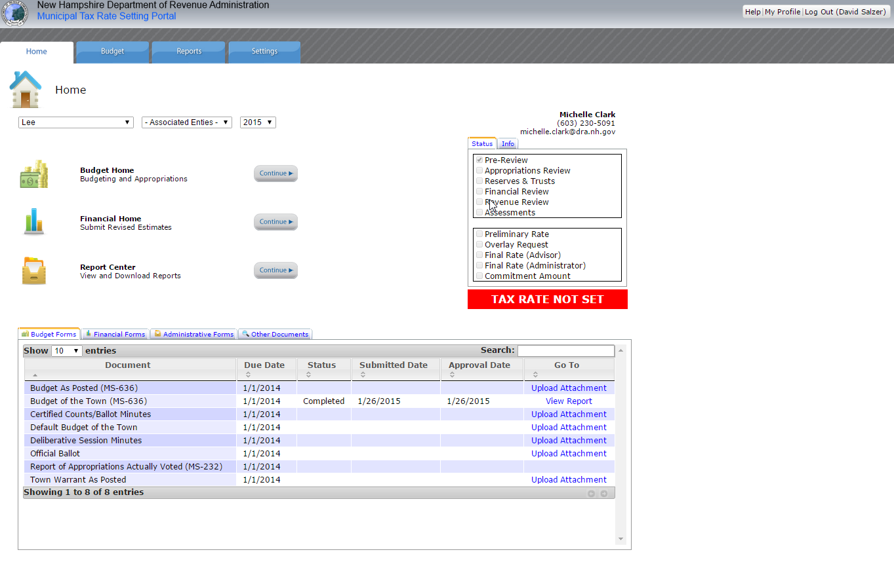
Home Page

Slide 11
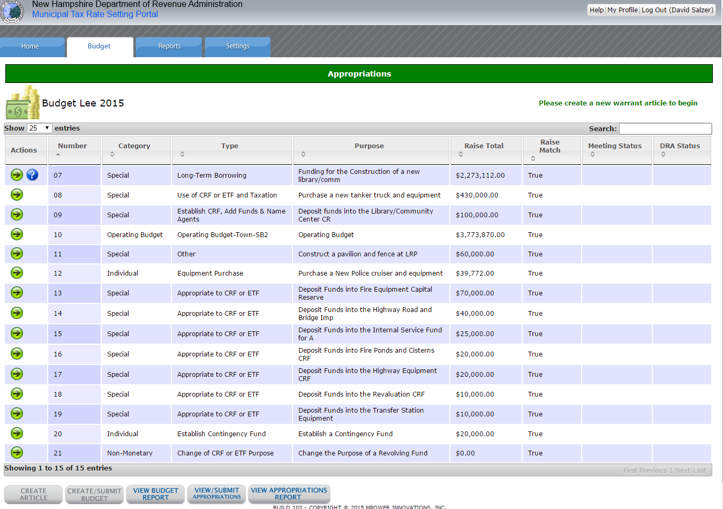
Budget Home

Slide 12
Appropriations-4 Steps
Convert all warrant articles (3 questions)
Submit appropriations as voted
Upload supplemental documentation
Print DRA “R” form

Slide 13
Converting Articles

Slide 14
Appropriations Conversion for Town/City/Village
Warrant Article Drafting &
Budget as Proposed
Appropriations Conversion and Submission
Town Meeting Info
Software
Word
1. Did the Warrant Article Pass or Fail?
MS-232
WA #1
Software
Software
PDF
2. Was the Warrant Article Amended?
Software
WA #2
MS-636
MS-6c
MS-737
MS-232
MS-232
3. Was Amendment Financial?
Software
Excel
WA #3
MS-232

Slide 15
Appropriations Conversion for Schools
Warrant Article Drafting &
Budget as Proposed
Appropriations Conversion and Submission
Town Meeting Info
Software
Word
1. Did the Warrant Article Pass or Fail?
MS-22
WA #1
Software
Software
PDF
2. Was the Warrant Article Amended?
Software
WA #2
MS-26
MS-26c
MS-27
MS-22
MS-22
3. Was Amendment Financial?
Software
Excel
WA #3
MS-22

Slide 16
DEMONSTRATION

Slide 17
Converting Special Types: Collective Bargaining

Slide 18
Collective Bargaining Agreement
Special process if you filed a CBA article WITHOUT breaking down the values in the appropriate account codes
Indicate “Financial Amendment” and break the values down

Slide 19
If your CBA Passes
Question 1: Pass
Question 2: Amended
Question 3: Financial Amendment
Break out values in the appropriations table

Slide 20
DEMONSTRATION

Slide 21
Converting Special Types: Default Budget

Slide 22
Default Budget
Two (2) scenarios
Drafted default budget in the system
Drafted default budget out of the system

Slide 23
Default Budget-In System
If Operating Budget fails
Indicate operating budget failed
Indicate default budget passed
If Operating Budget passes
Indicate operating budget passed
Indicate default budget failed

Slide 24
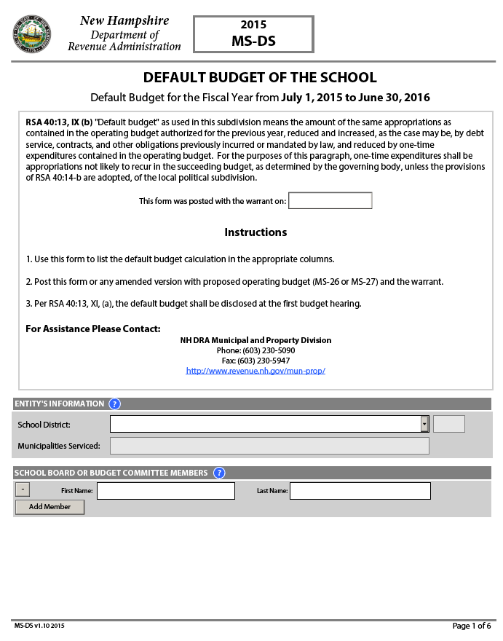
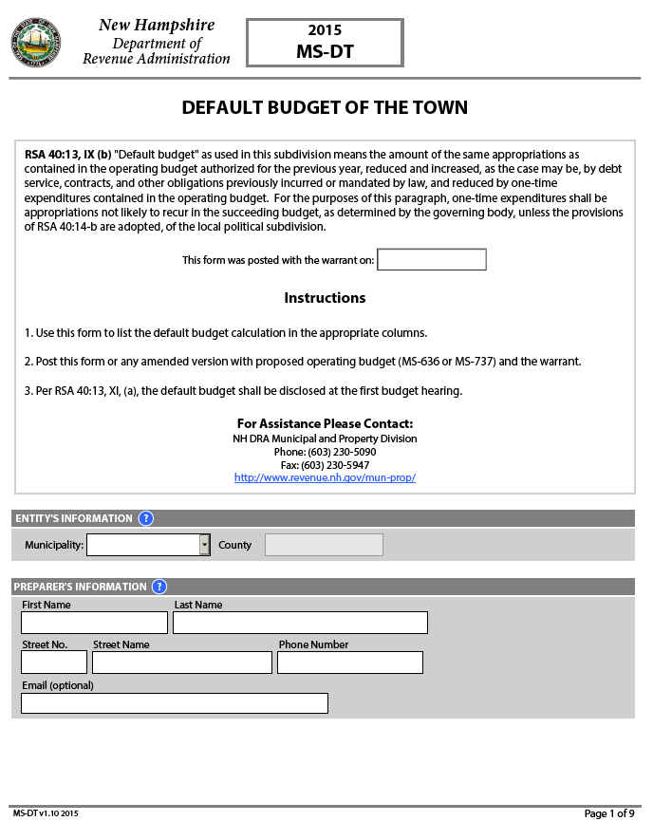
Default Budget-Out of System
Operating Budget Fails
Indicate it passed with a financial amendment
In amendment block indicate that the operating budget failed and the values in the account code table are the default values
Update the account code table to include default amounts

Slide 25
DEMONSTRATION

Slide 26
Submit appropriations as voted

Slide 27
DEMONSTRATION

Slide 28
Supplemental documentation

Slide 29
Supplemental Documentation
All Entities
Budget as posted
Warrant as posted
Meeting minutes
Additional for SB-2
Certified counts/Ballot Minutes
Official Ballot
Deliberative session minutes

Slide 30
DEMONSTRATION

Slide 31
DRA Approval

Slide 32
DRA Approval
DRA will review annual meeting information and make adjustments to Appropriations as Voted as necessary
Email will be sent when process is complete
Log in, and download your “R” form (MS-232R/MS-22R)

Slide 33
DEMONSTRATION

Slide 34
Resources
Username request email
Help Videos
www.t2.unh.edu/dra-municipal-services
Complete user manual
www.revenue.nh.gov/msmanual
http://revenue.nh.gov/mun-prop/municipal/municipal-software.htm
Municipal advisor
T² staff

Slide 35
Questions

